Slide 1



$$\vec{v}$$
$$B_{2}$$
$$B_{1}$$

Slide 2


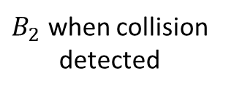
$$\vec{v}$$
$B_{2}$ when collision
detected
$$B_{1}$$
$$d$$
$B_{2}$ at TOI

Slide 3



$$\vec{v}$$
$B_{2}$ when collision
detected
$$\vec{c}$$
$$B_{1}$$
$$θ$$
$$d$$
$B_{2}$ at TOI
$$δ$$

Slide 4









$\vec{v}$=[$v_{x}$, $v_{y}$]
$$[p_{x},p_{y}]$$
$$d_{1}$$
$$p_{y}−w_{y}$$
POI
$$θ$$
$$θ$$
$$y=w_{y}$$
$$d_{2}$$
$$r$$

